Slide 1

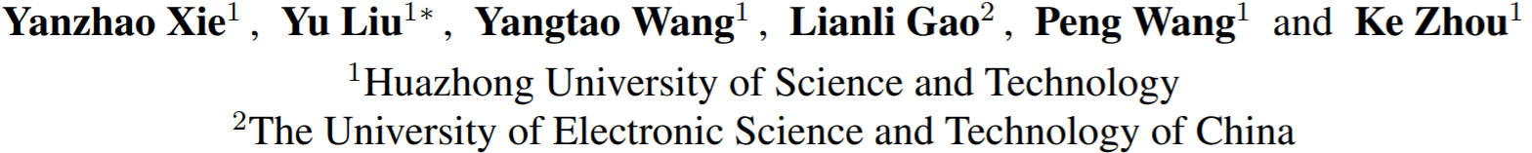



Label-Attended Hashing for Multi-Label Image Retrieval
Presenter： Yanzhao Xie

Slide 2

Abstract
Existing hashing algorithms neglect the dependency between objects in a multi-label image.
Fail to capture the attention information in the feature extraction.
Disadvantages mentioned above limit the precision of hash codes in some degree.
We use MFB structure, GCN structure, Cauchy Loss function.

Slide 3
华中科技大学
Huazhong University of Science and Technology
Background
Previous solutions
Proposed Methodology
Experiments
Conclusion

Slide 4
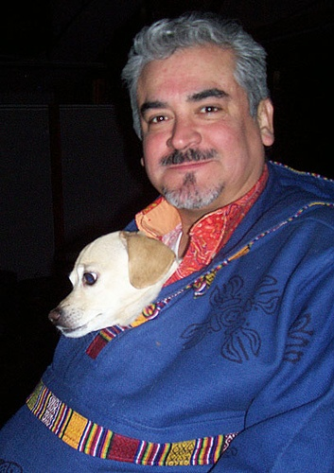
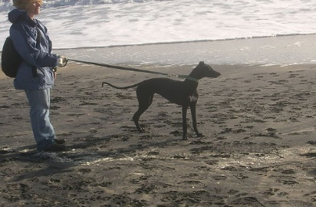
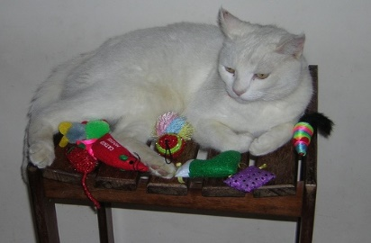
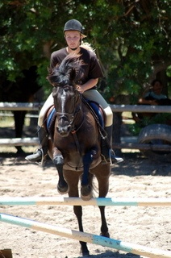
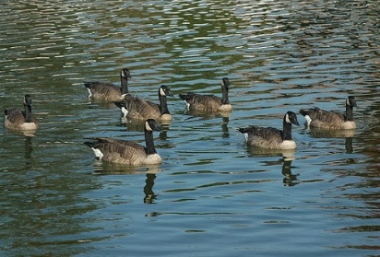

Background
bird
person+dog
person+dog
cat+chair
bird
person+horse
duck+lake
person+boat+sea
single-label image
multi-label image
Multi-label images are more common in the real world and multi-label image recognition has always been a research hotspot in the computer vision field.

Slide 5
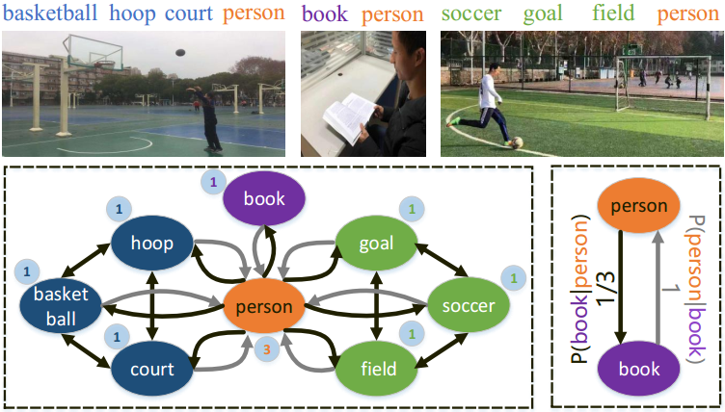
华中科技大学
Huazhong University of Science and Technology
Background
as example, when “person” appears in the image, “book” will occur with probability 33.33%.
However, in the condition of “book” appearing, “person” will certainly occur with probability 100%
Two key challenges：
how to construct an ideal topology structure and what kind of dependency should be expressed.
how to use the topology information to learn image representations in the hash task via an end-to-end manner.

Slide 6
华中科技大学
Huazhong University of Science and Technology
Background
Previous solutions
Proposed Methodology
Experiments
Conclusion

Slide 7
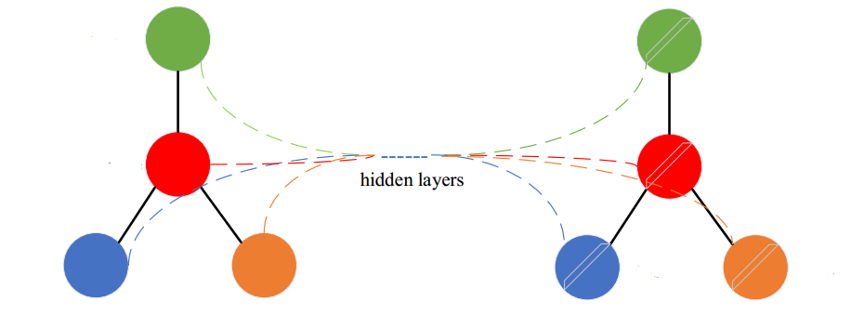
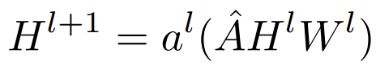
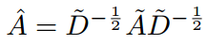
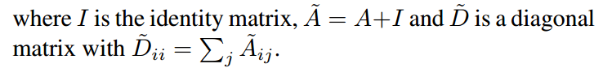
Previous Solution
Graph convolution network (GCN)
H: the feature matrix of nodes
W: the weights of GCN
A: the correlation matrix between nodes
Node features
Correlation matrix
GCN
(the normalized version of A)
Updated node features

Slide 8
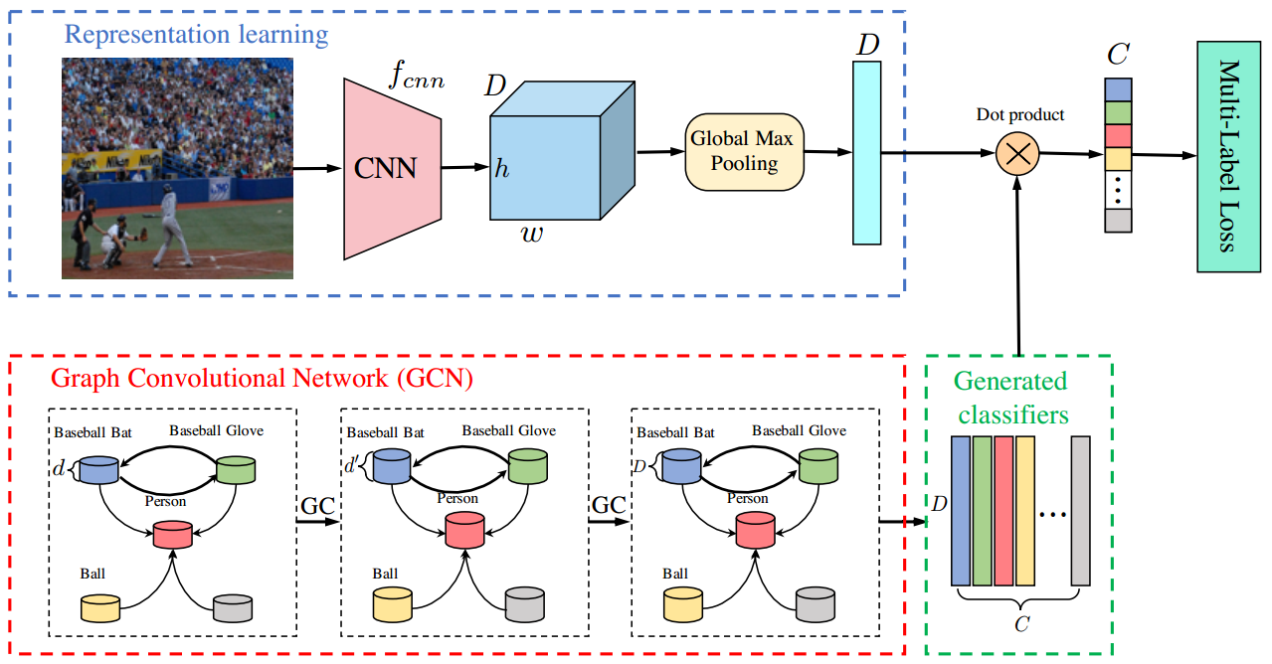

Previous Solution
Step 1:
CNN
image
image feature
label
GloVe
label embedding
Step 3:
image feature
Step 2:
label statistical information
DP
classification
label embedding
label co-occurrence embeddings
GCN
correlation matrix
label embedding
ML-GCN: Multi-Label Image Recognition with Graph Convolutional Networks (CVPR 2019)

Slide 9
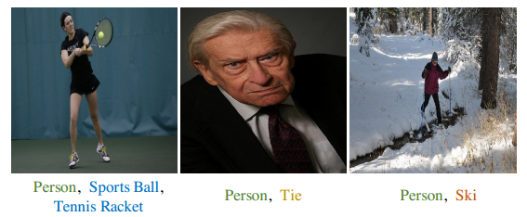
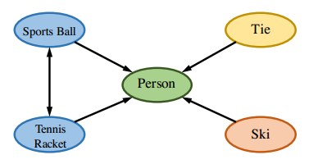
Previous Solution
image feature
image
different modalities
low fusion efficiency
Label co-occurrence embeddings
text

Slide 10
华中科技大学
Huazhong University of Science and Technology
Background
Previous solutions
Proposed Methodology
Experiments
Conclusion

Slide 11
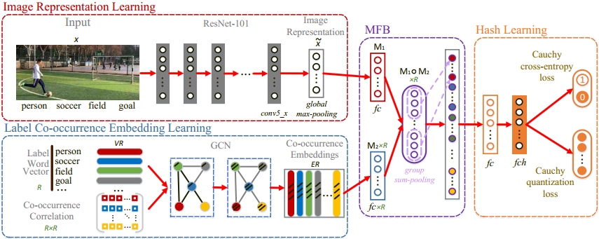
Proposed Methodology
Overall architecture of LAH
Image representation from ResNet-101
Label co-occurrence embeddings from GCN
Use MFB module
Cauchy distribution for hash learning

Slide 12
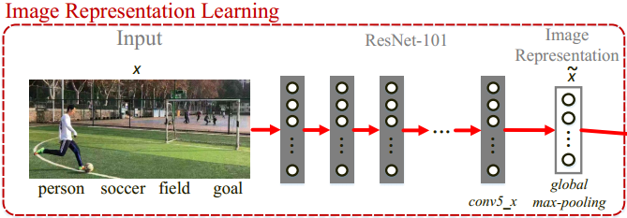
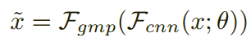
Proposed Methodology
input : 448*448
conv5_x output：2048*14*14
GMP output: 2048 * 1
CNN network, i.e.,ResNet-101, for learning deep representation of each image.
Any CNN based models can complete the feature extraction of an image in our architecture. In our experiments, we choose ResNet-101 as the model.

Slide 13
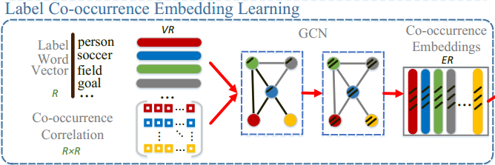
Proposed Methodology
GCN for learning label co-occurrence embedding, where R denotes the number of labels, VR denotes the set of label vectors and ER denotes the set of co-occurrence embeddings.
For the second challenge, we first combine Graph Convolutional Network (GCN) and Word2Vector method to learn the label co-occurrence embeddings. these embeddings can well express the features of co-occurrence correlation.

Slide 14
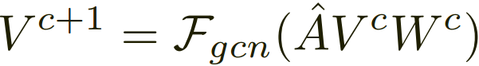
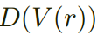

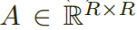
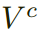
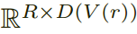
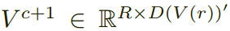
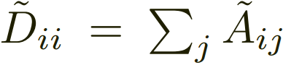
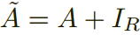
Proposed Methodology
is the dimension of .
Correlation matrix .
represents the input in c-th layer of GCN module. The (c+1)-th input can be written as .
with and .

Slide 15
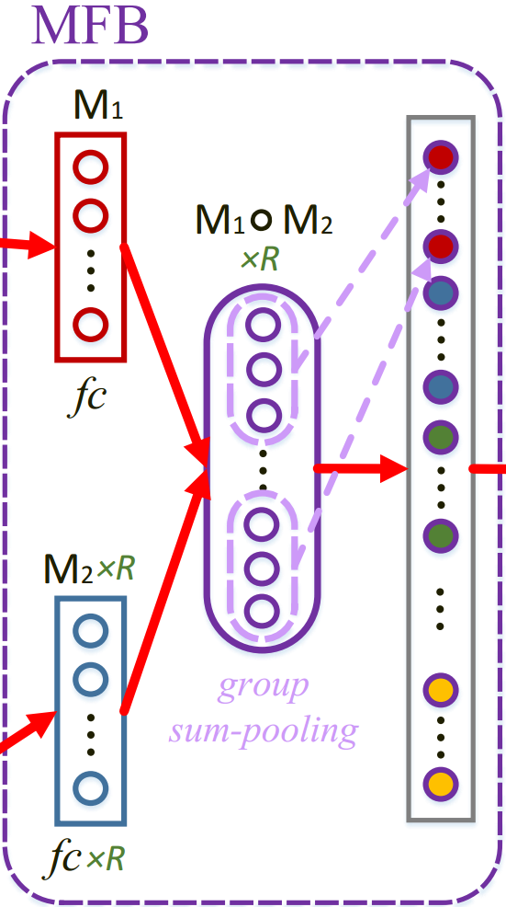
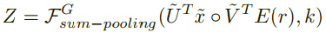
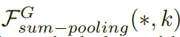
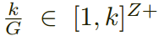
Proposed Methodology
The MFB(e.g. Multi-modal Factorized Bilinear pooling component) is one of the keys to achieve high precision with fast learning efficiency for LAH.
a MFB for efficiently fusing image representation and label co-occurrence embedding.
the function means using a one-dimensional non-overlapped window with the size to perform sum-pooling over *.
.

Slide 16
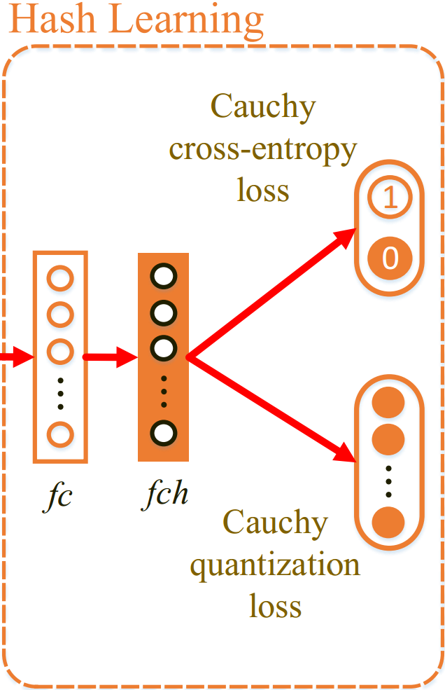
Proposed Methodology
Cauchy distribution can adjust the location of data peak to embody the focus of attention.
Cross-entropy loss and quantization loss based on the Cauchy distribution which respectively aim at similarity hash learning and hash codes quality controlling.

Slide 17
华中科技大学
Huazhong University of Science and Technology
Background
Previous solutions
Proposed Methodology
Experiments
Conclusion

Slide 18
Experiments
Experimental settings:
Tool: Pytorch
Feature extraction model: ResNet-101
GCN: 2 layers
Training: SGD
Learning rate: 0.1
Batchsize: 32
Evaluation metrics:
Convergence efficiency
MAP@H≤2, P@H≤2, R@H≤2, etc.
Experimental results:
Convergence efficiency comparisons
MAP@H≤2 Results
P@H≤2, R@H≤2 Results
Ablation study
Visualization results
Datasets:
MS-COCO
VOC-2007
MIR-FLICKR25k

Slide 19
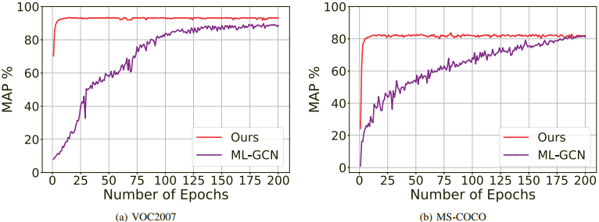
Experiments
1. Convergence efficiency
The above figure shows the efficiency of MFB.
LAH has already converged on the 15-th and 17-th epoch, and obtained the best MAP of 93.43% and 82.40% respectively. However, at the same epoch, ML-GCN never converges and its MAP scores are respectively 72.91% and 38.39% lower than LAH on VOC2007 and MS-COCO.

Slide 20
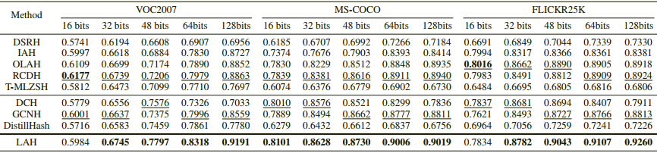
Experiments
2. MAP@H≤2 Results
The Mean Average Precision within Hamming Radius 2 (MAP@H≤2) of all comparison methods are listed in Table above.
Experimental results show LAH has stable advantages over other algorithms at different code lengths and averagely outperforms .

Slide 21
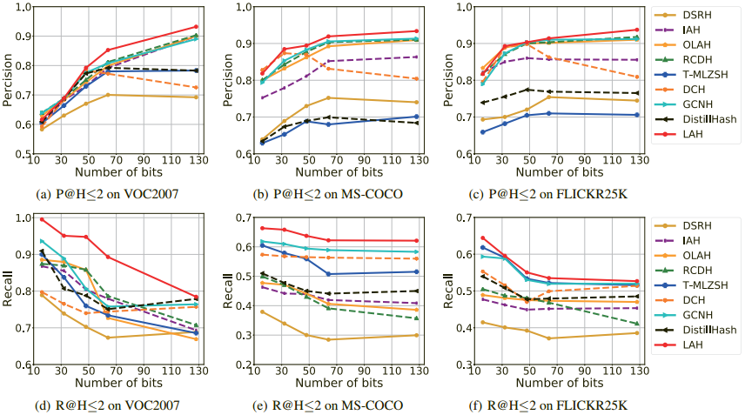
Experiments
3. P@H≤2, R@H≤2 Results
As shown in subfigure (a), (b) and (c), LAH achieves the highest P@H≤2 results on all the three benchmark datasets at different code lengths.
As shown in subfigure (d), (e) and (f), LAH also achieves the highest R@H≤2 results on all the three datasets.

Slide 22
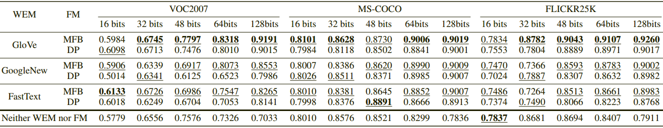
Experiments
4. Ablation study
We compare the performance under GloVe with other popular counterparts including GoogleNews and FastText. (result: GloVe is the best).
Fusion method (FM) is a LAH component used to fuse the label information and image feature. We compare the performance under MFB and DP which is used in MLGCN. (result: MFB is better than DP).

Slide 23
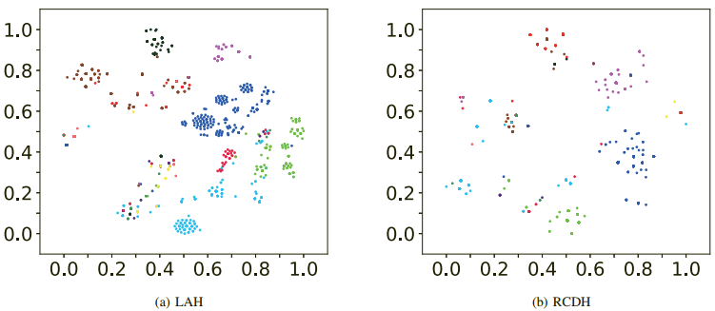
Experiments
5. Visualization results
The t-SNE visualization of the hash codeslearnt by LAH and our baseline RCDH on VOC2007 dataset. LAH can not only better distinguish different categories but also gather the same categories more compactly. Although RCDH is equally excellent, its effect is not as good as LAH.

Slide 24
华中科技大学
Huazhong University of Science and Technology
Background
Previous solutions
Proposed Methodology
Experiments
Conclusion

Slide 25
Conclusion
LAH adopts co-occurrence probability over the label set to explore the interdependency between objects and uses GCN to learn the co-occurrence embeddings.
LAH utilizes MFB to fuse the image representations and label co-occurrence embeddings in an end-to-end manner, which integrates the multi-modal co-attention as well as promotes the learning efficiency.
Extensive experiments on VOC2007, MS-COCO and FLICKR25K demonstrate LAH has a high convergence rate and can generate high-quality hash codes and achieve better retrieval results than the state-of-the-art hashing methods.

Slide 26
Label-Attended Hashing for Multi-Label Image Retrieval
Thank You!
Contact me: yzxie@hust.edu.cn

